Slide 1
2023 NWSAM
Spring Scale Opener

Slide 2
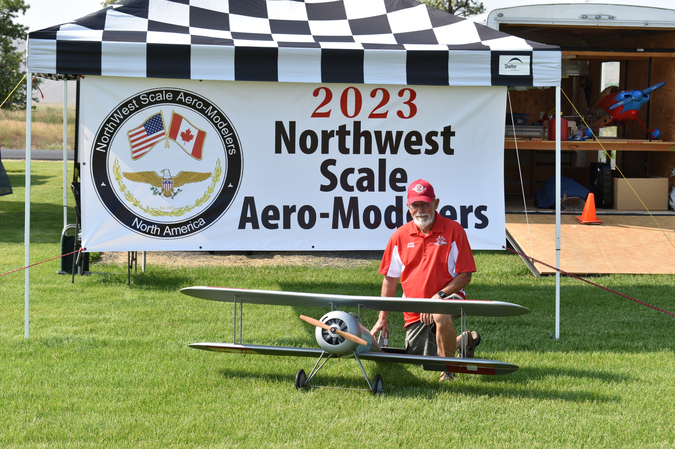
Doug Stewart- 1st in Expert. C28 Nieuport

Slide 3
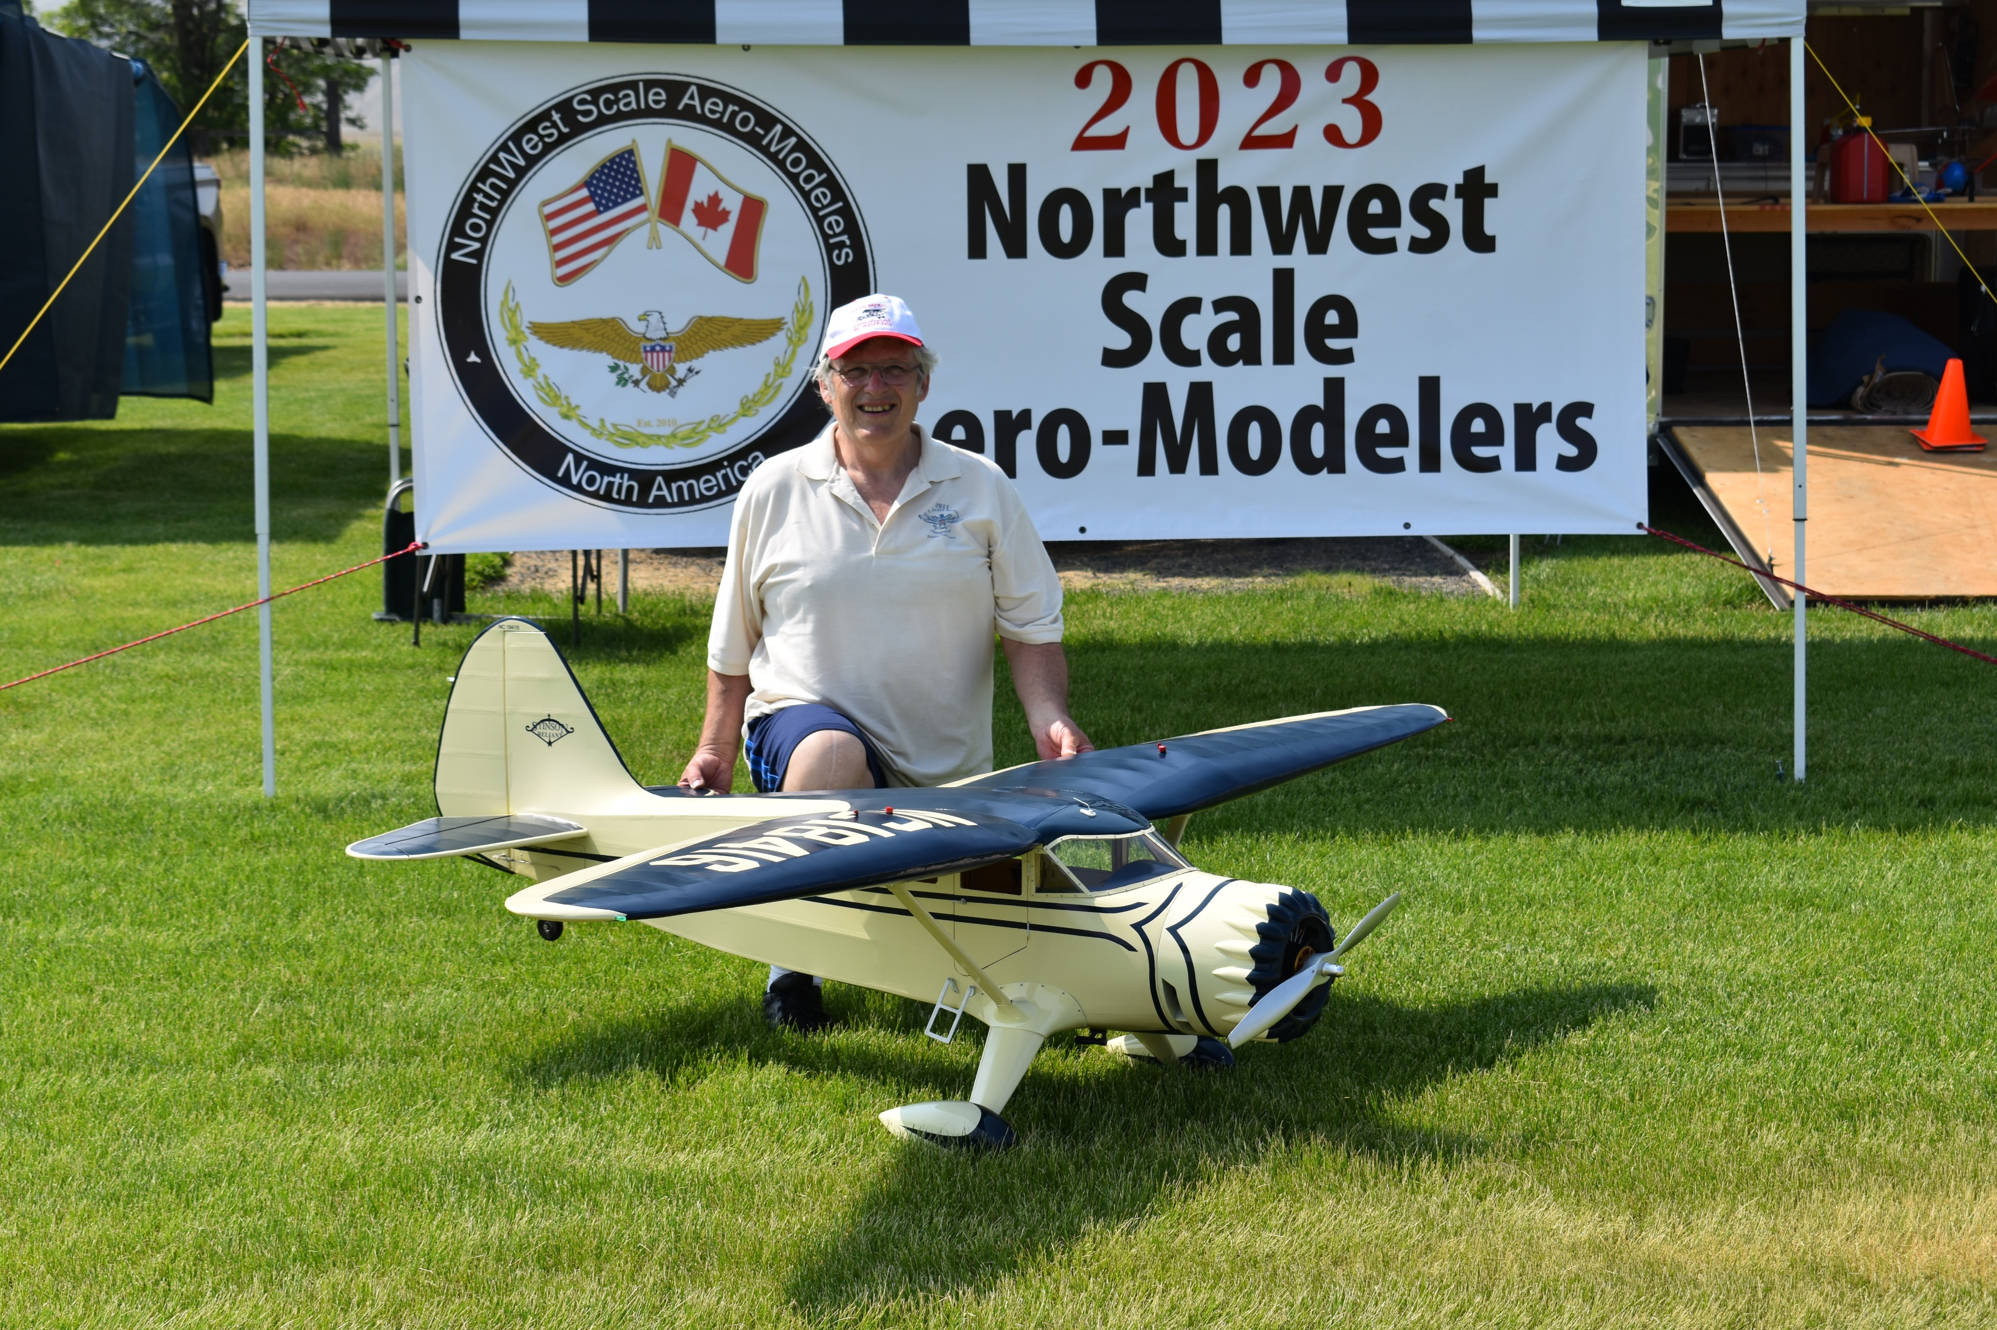
Randy Smithhisler- 2nd in Expert. Stinson

Slide 4
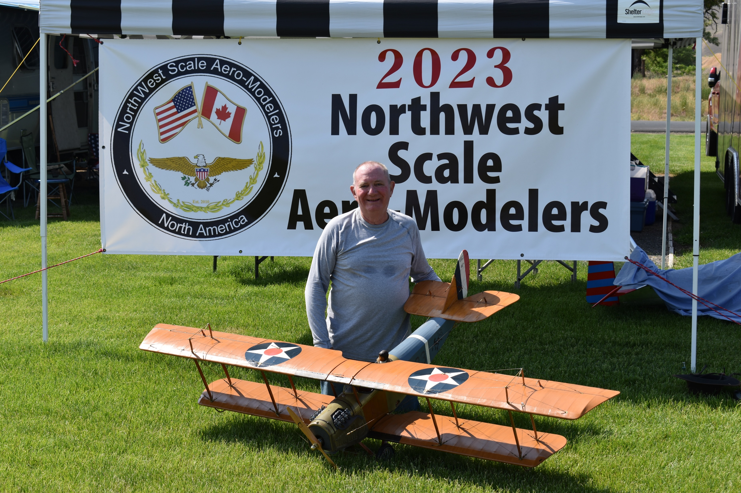
Scott Enochs- 3rd in Expert. Jenny JN4

Slide 5
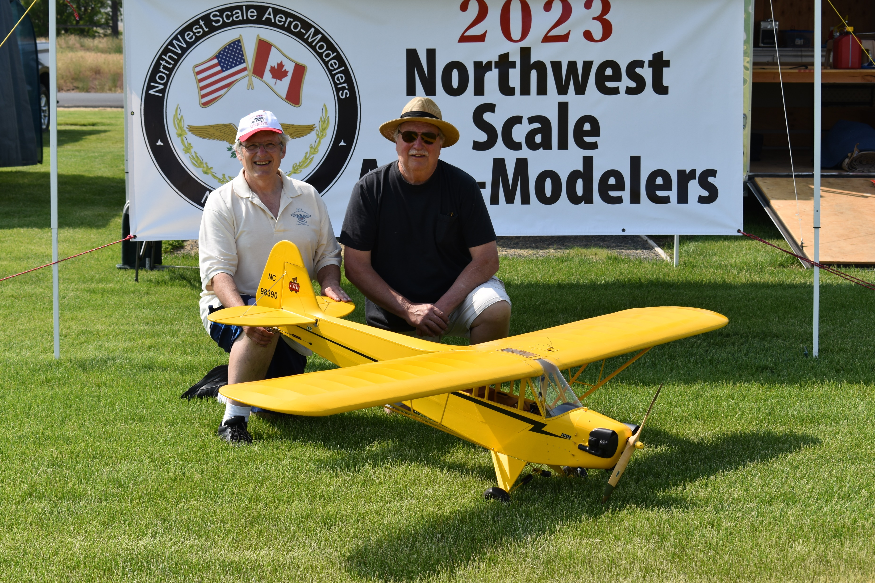
Randy Hansen flying Randy Smithhisler’s J-3 Cub- 1st in Team [ Randy is the one on the left ;) ]

Slide 6
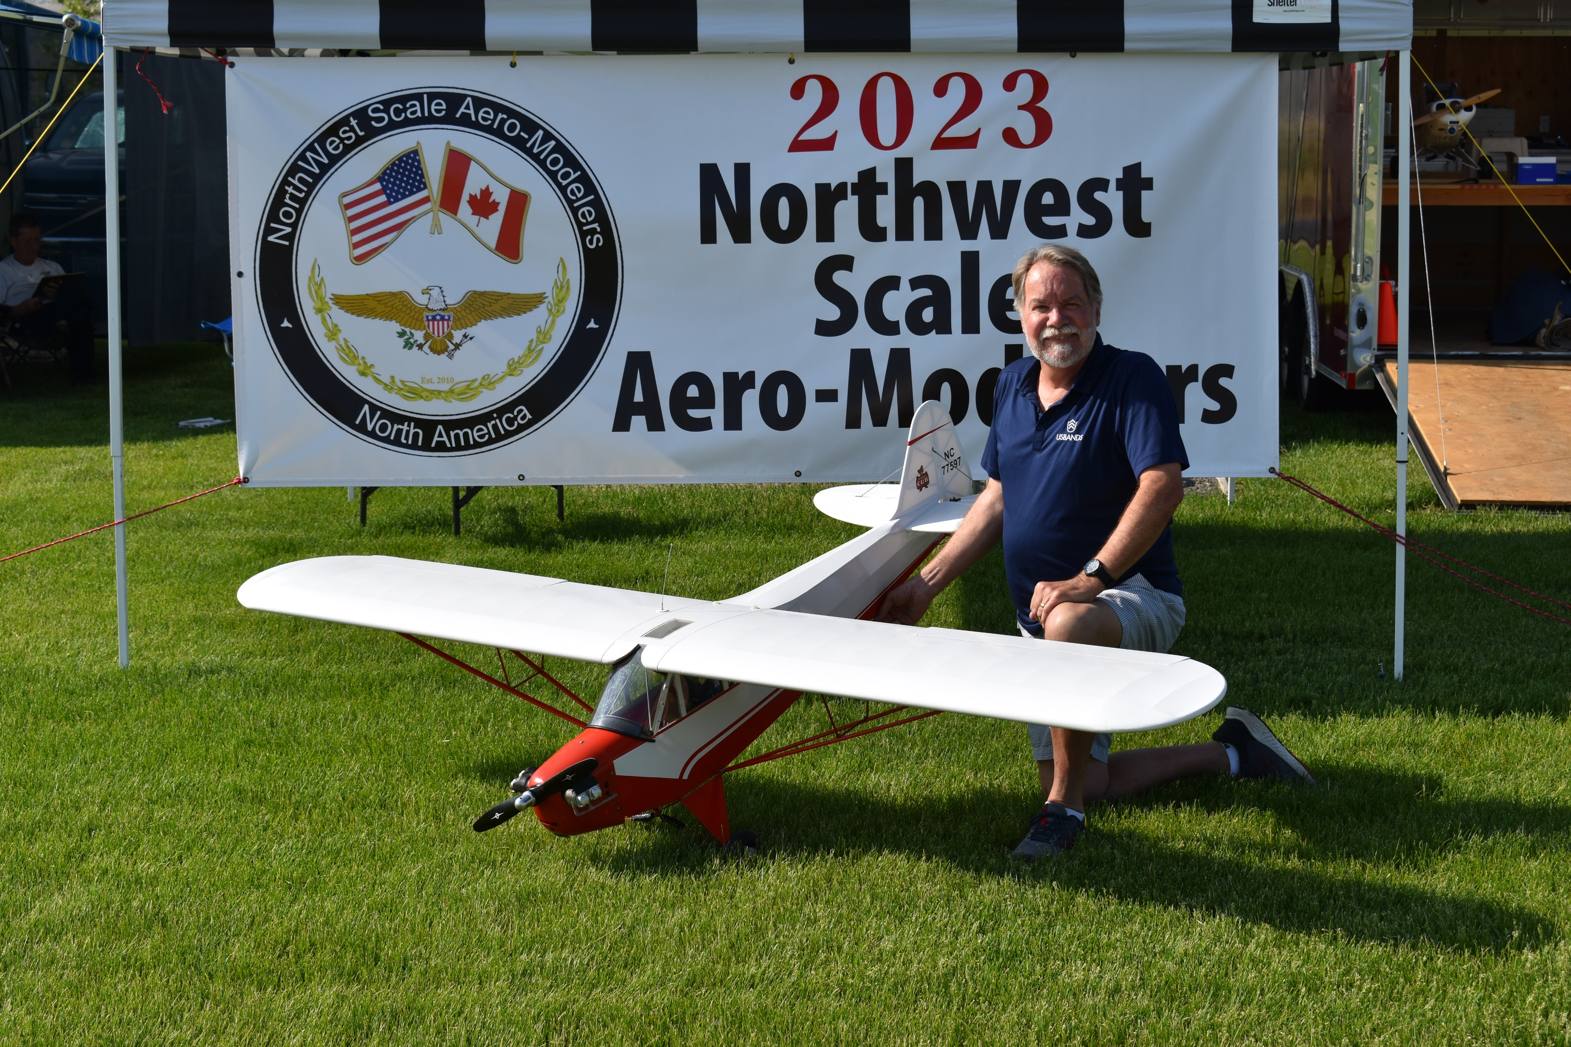
CD Patrick Winters- 1st in Advanced. J-3 Cub C-65

Slide 7
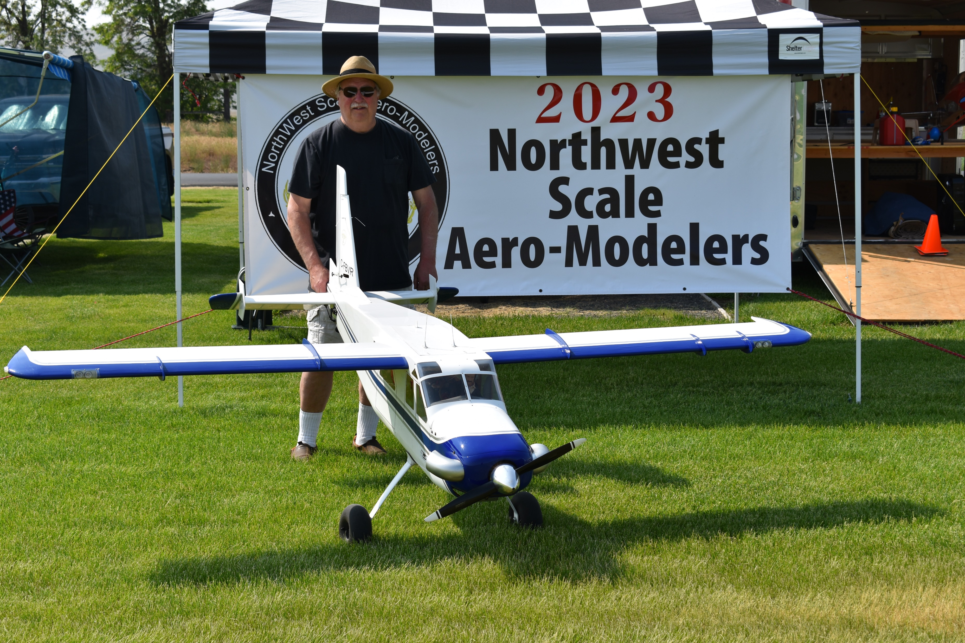
Randy Hansen- 1st Pro/Am Unlimited. Turbo Beaver

Slide 8
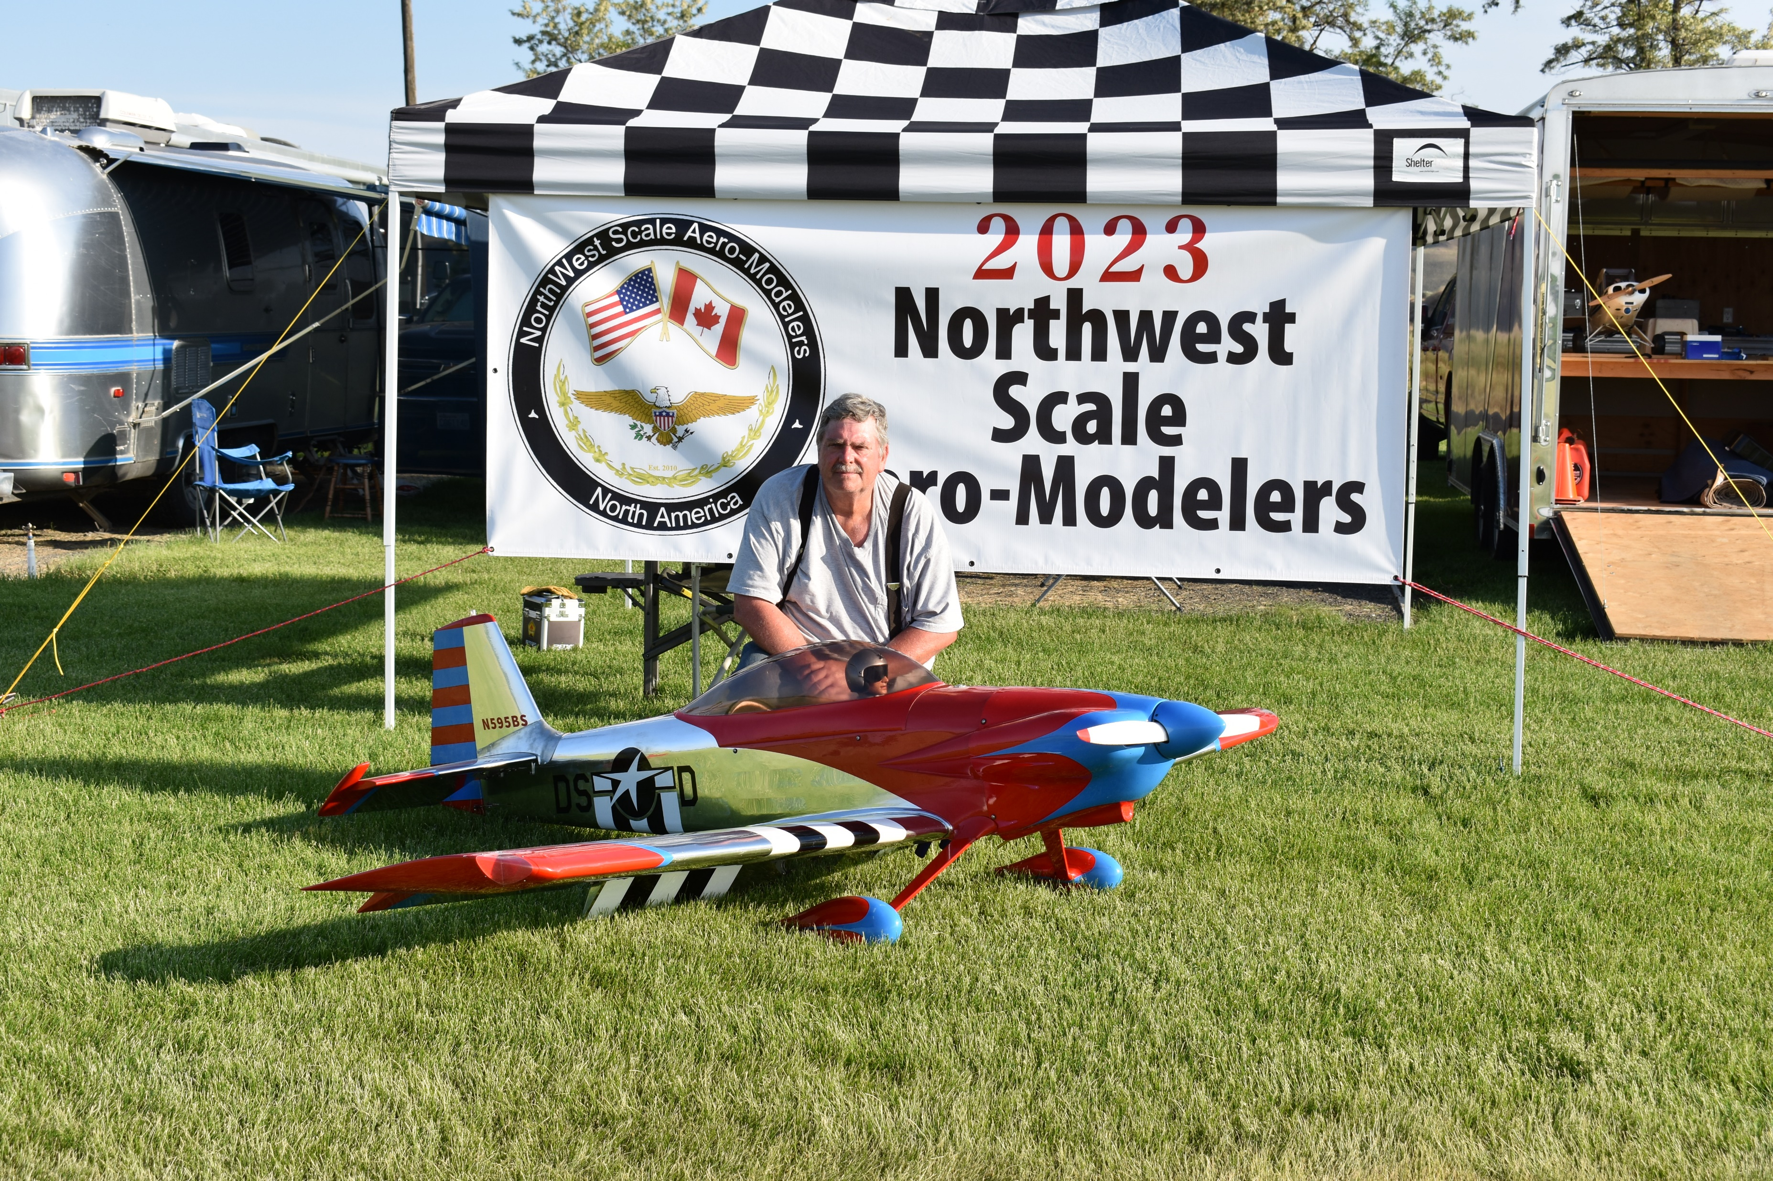
Mike Ingram- 2nd Pro/Am Unlimited. RV-4

Slide 9
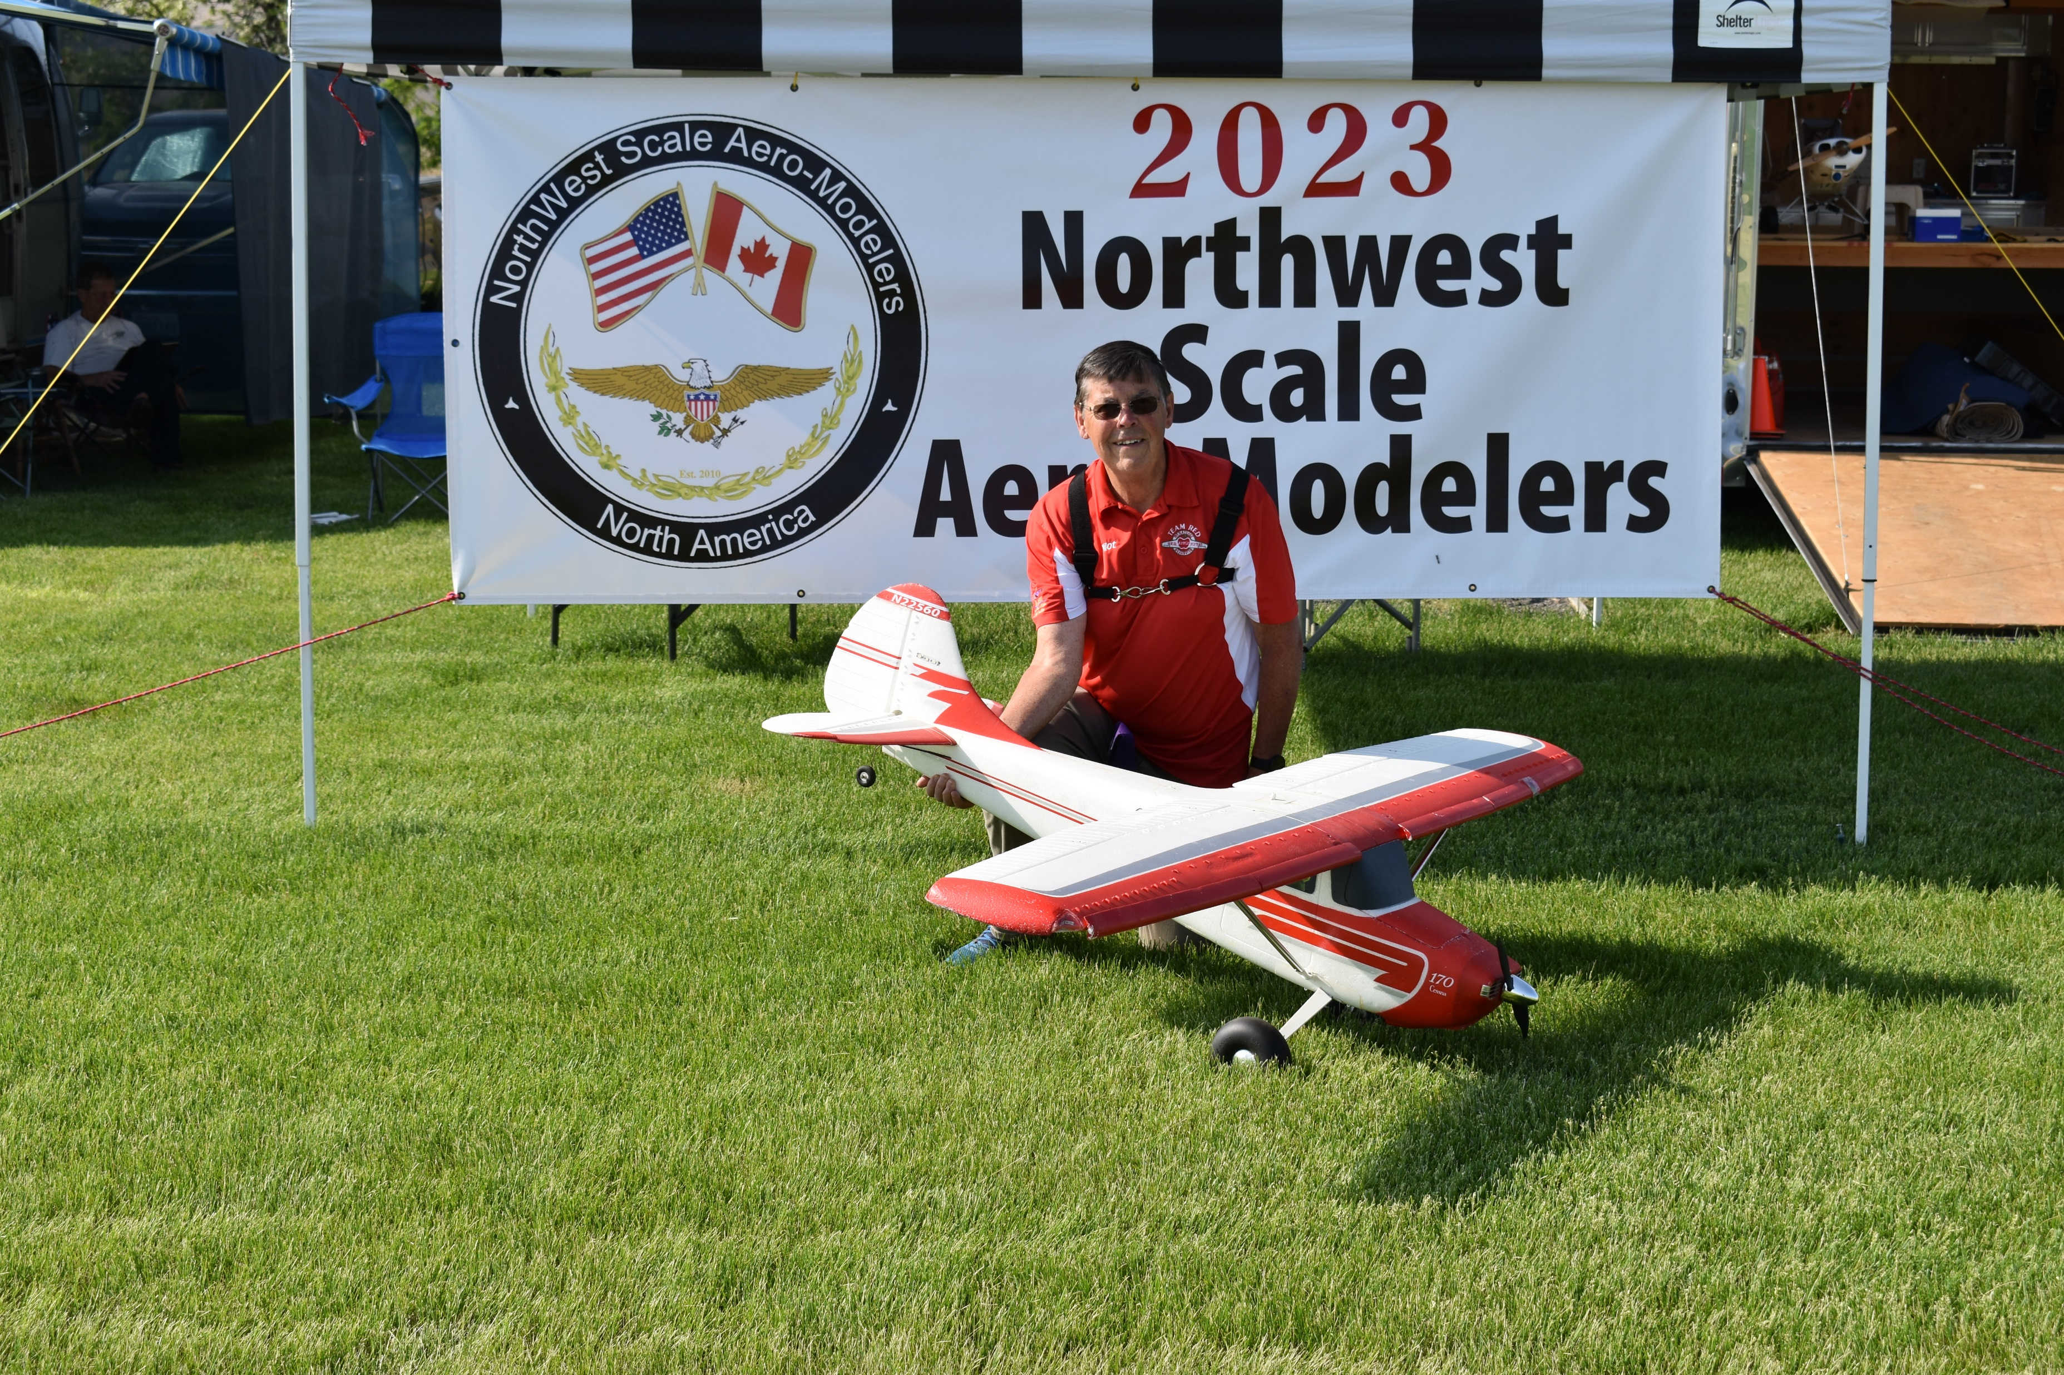
Roly Worsfold- 2nd Pro/Am Unlimited. Cesna 170

Slide 10
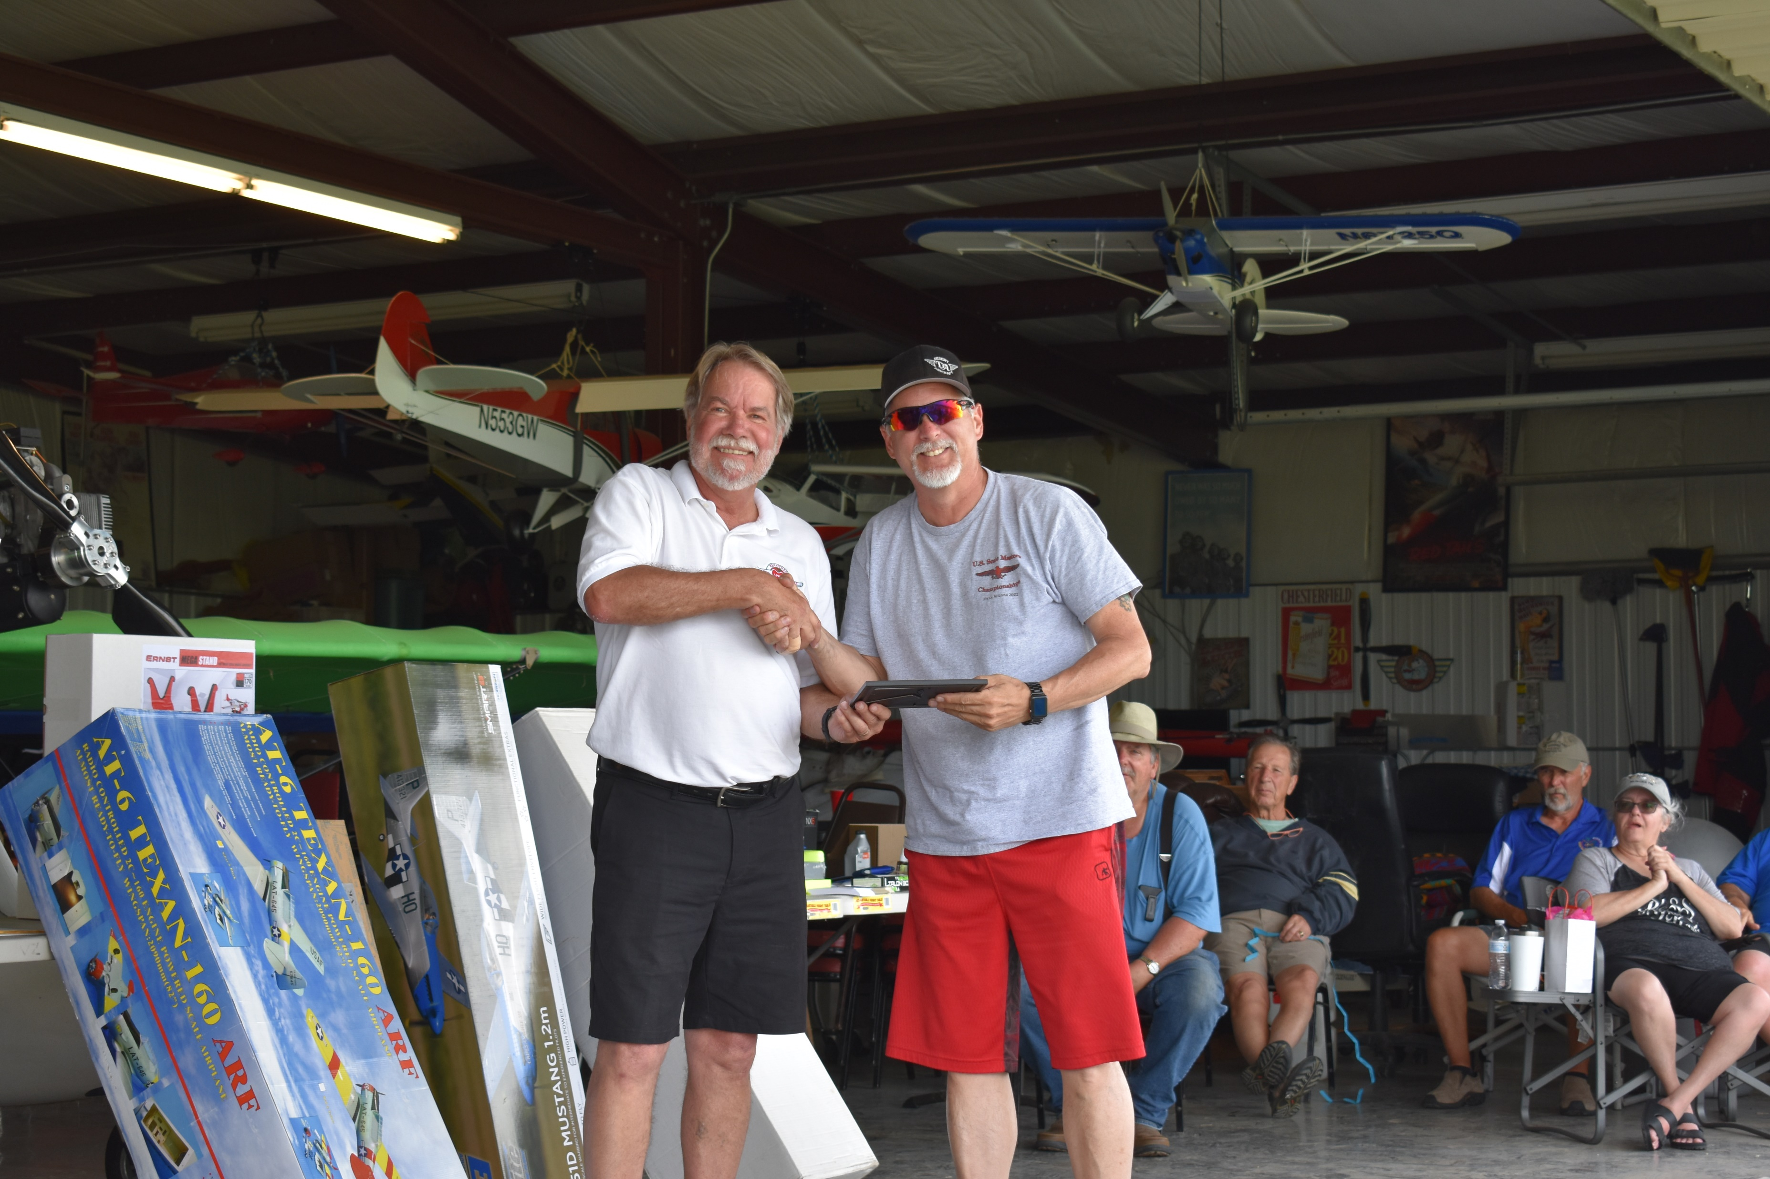
Gale Vasquez- 1st Pro/Am Pro. Extra 300

Slide 11
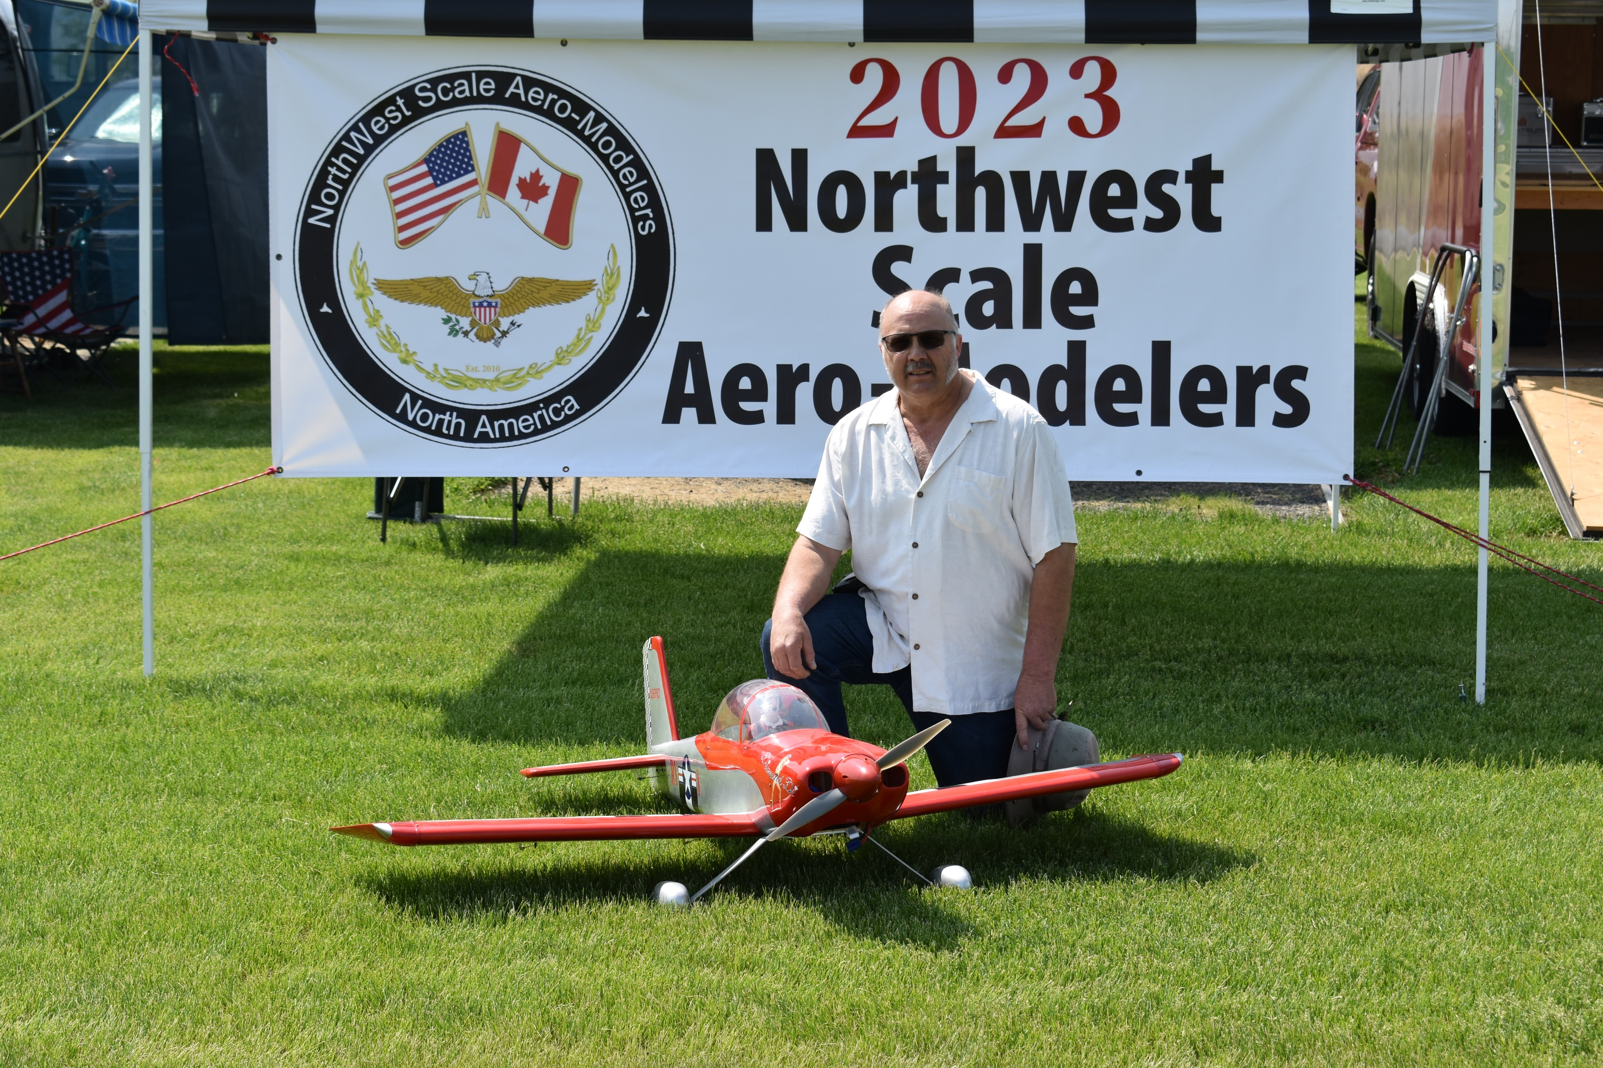
Joe Ball- 2nd Pro/Am Pro. RV-8

Slide 12
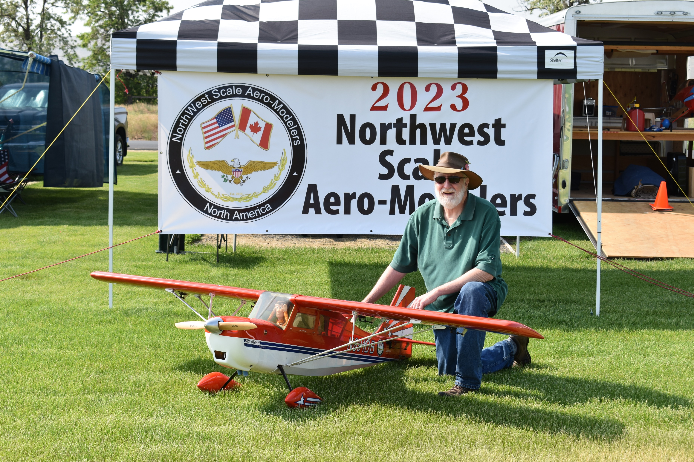
Tom Rainwater- 3rd Pro/Am Pro. Decathalon

Slide 13
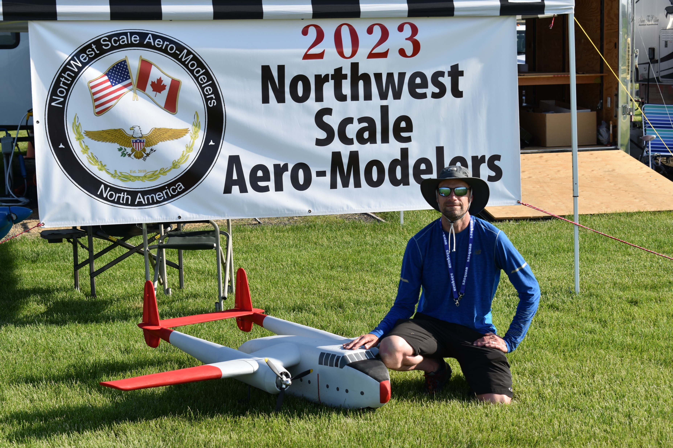
Mitchell Beckman- 1st Pro/Am Sportsman. C-82

Slide 14
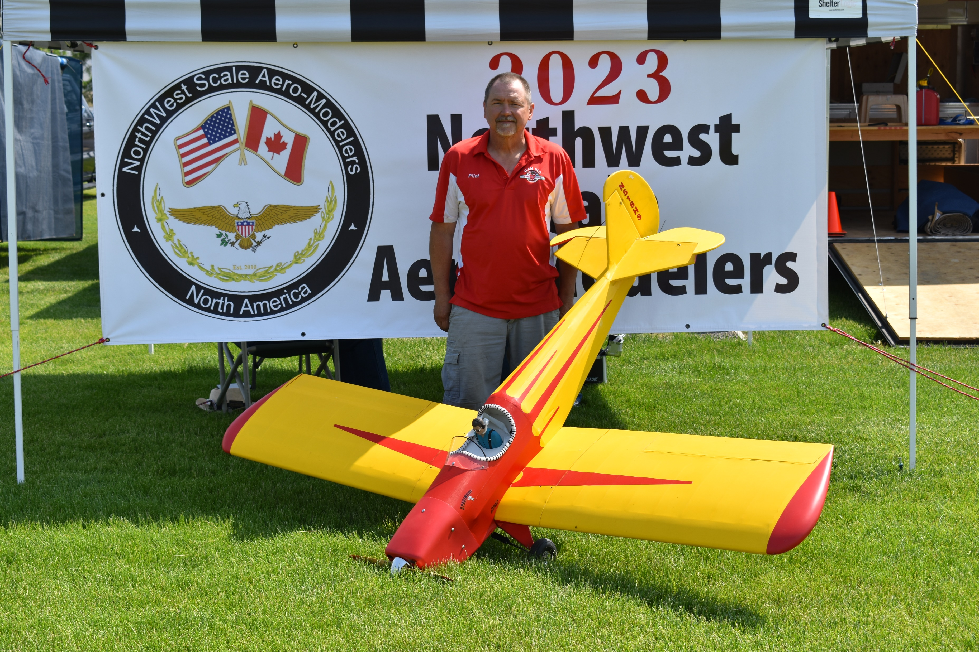
Dave Moline- 2nd Pro/Am Sportsman. Spacewalker

Slide 15
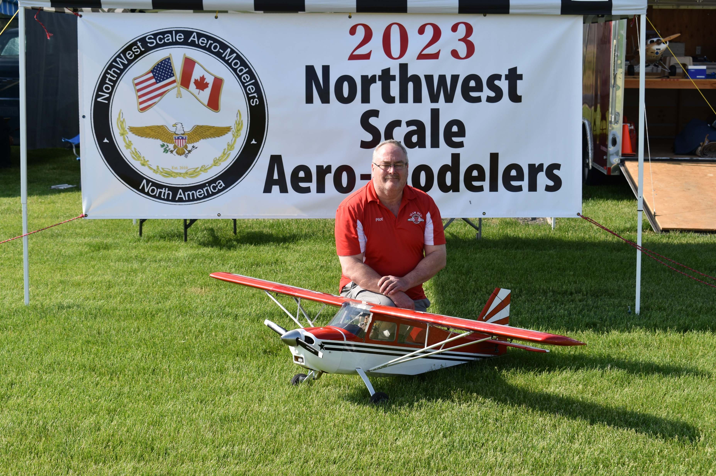
Robert Moore- 3rd Pro/Am Sportsman. Citabra

Slide 16
PRIZES
With Thanks to so many- including:
Horizon Hobbies
Bigfoot Hobbies
RTL
Tru-Turn

Slide 17
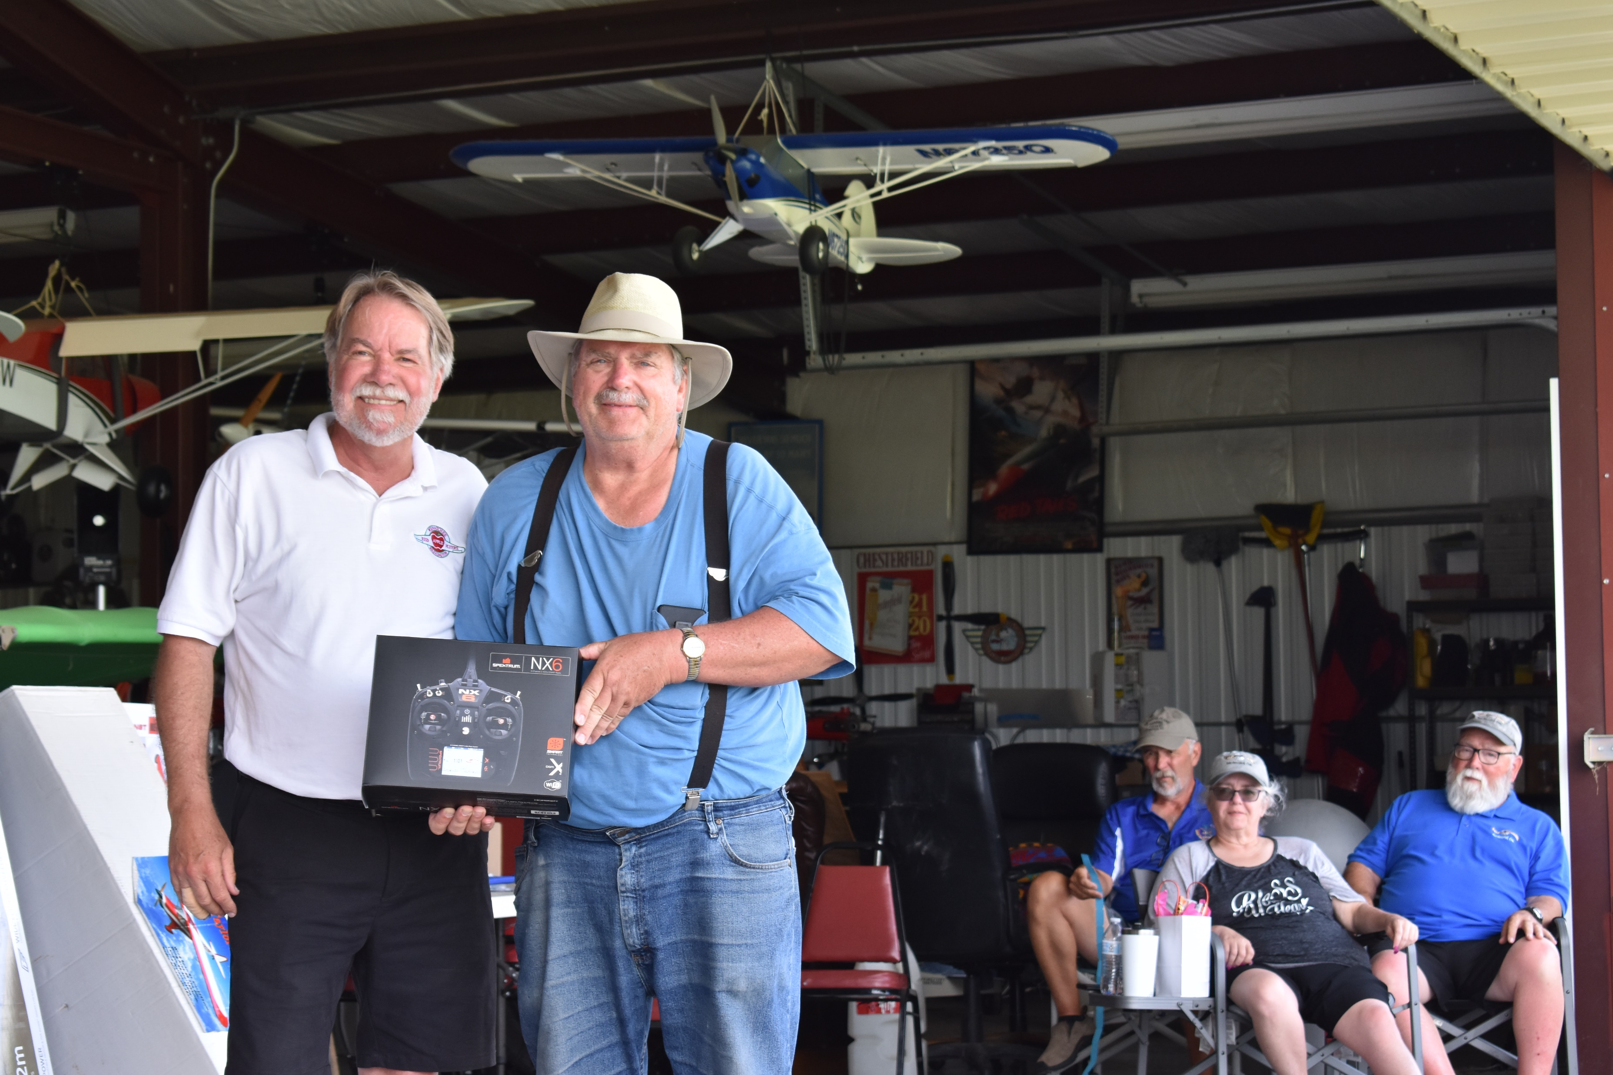
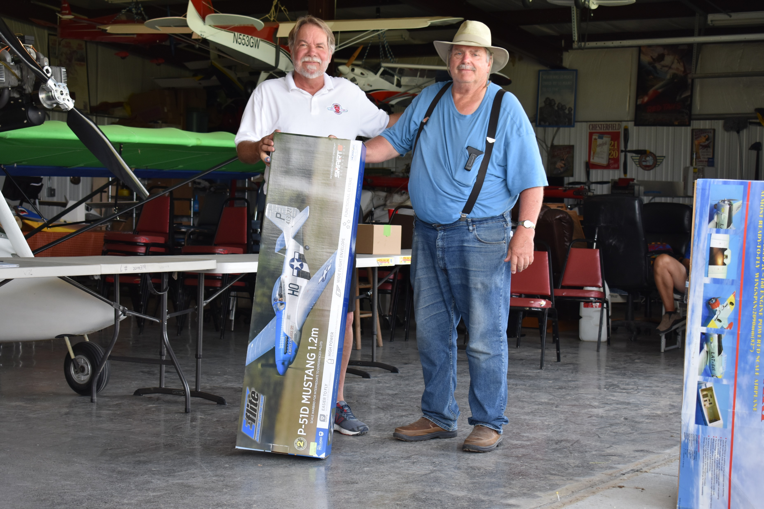
Mike Ingram wins a radio from Horizon Hobbies and a kit from Bigfoot Hobbies .

Slide 18
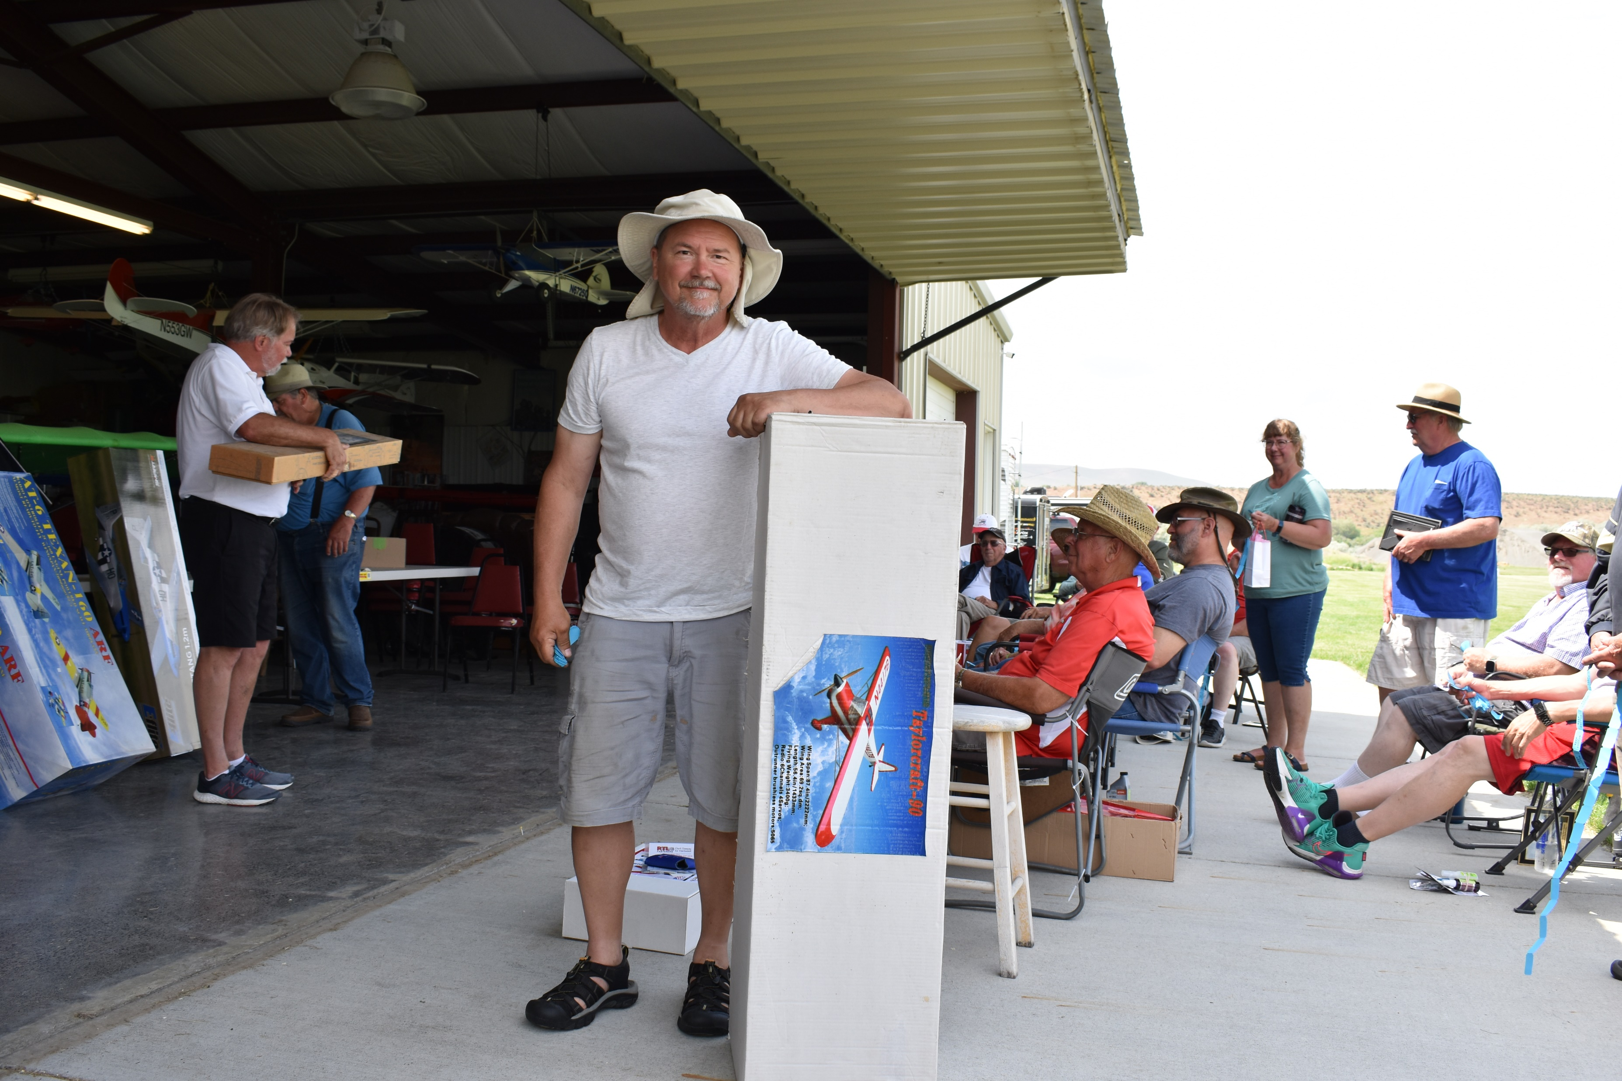
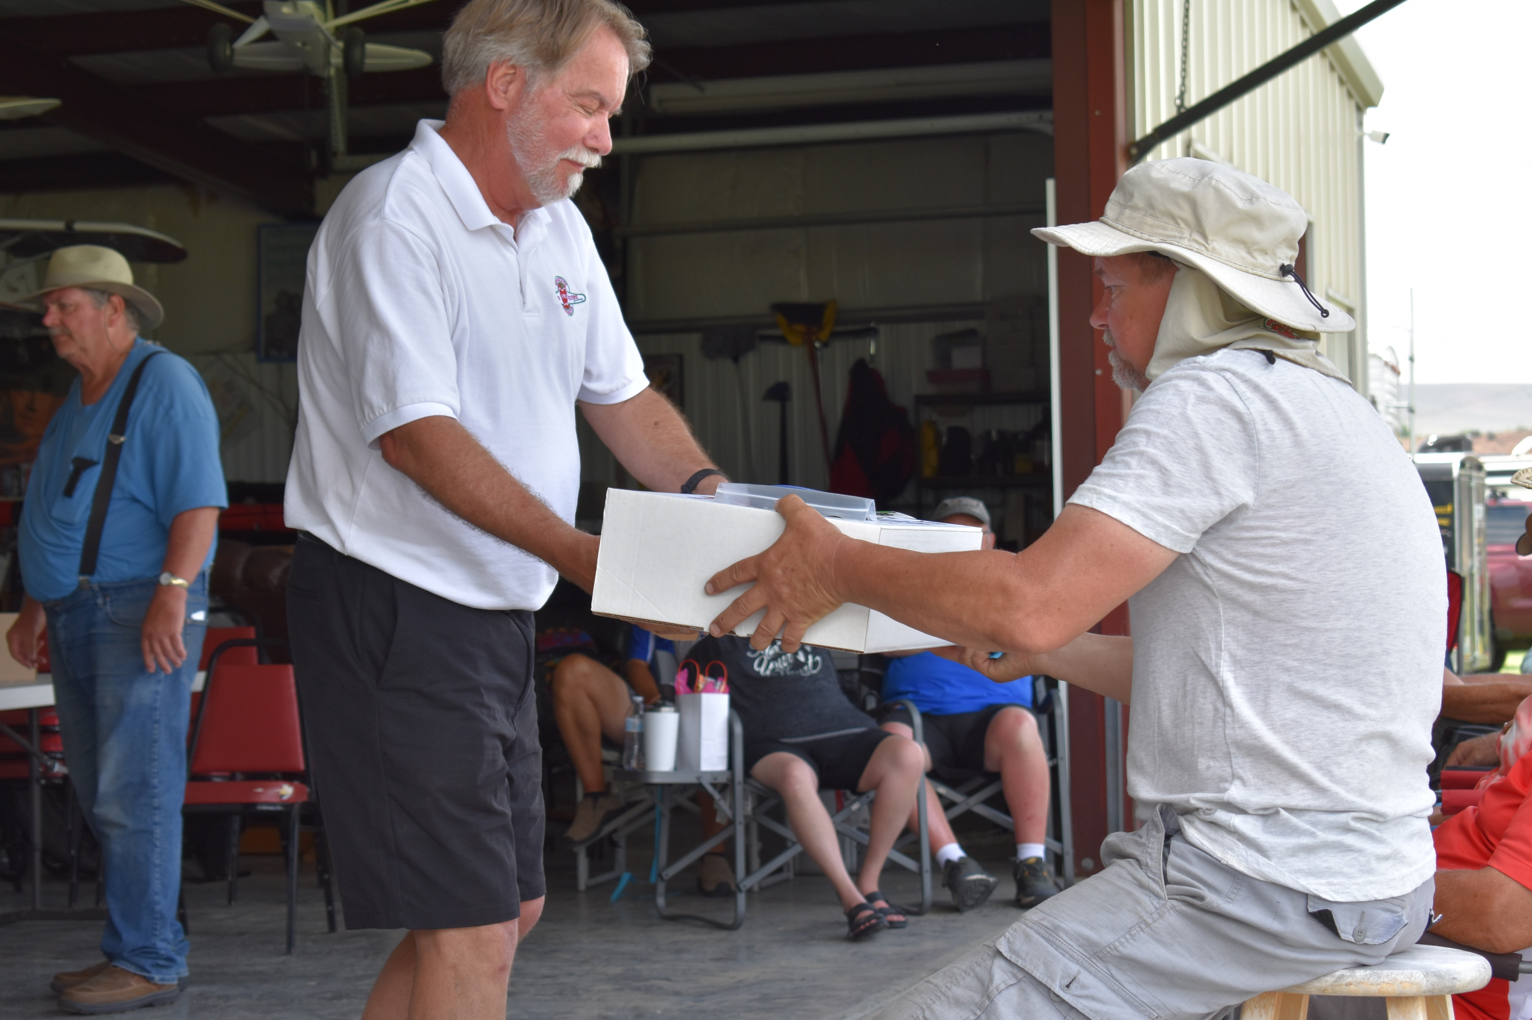
Two of Dave Moline’s wins.

